Slide 1
Sales Dashboard DesigN
Tool: PowerBI

Slide 2
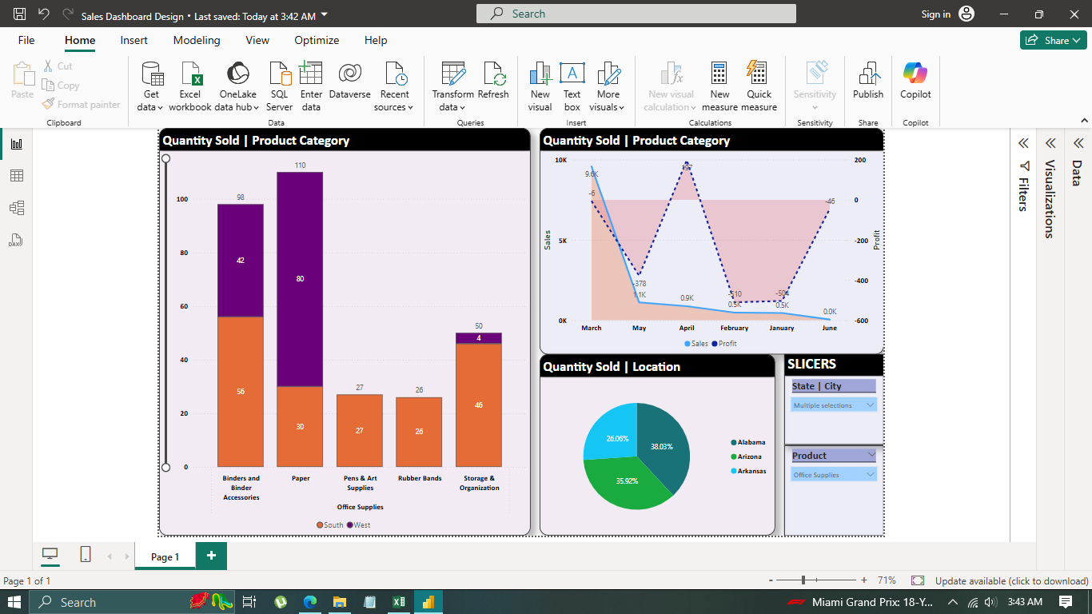

Slide 3
INSIGHTS
Among Office Supplies, Binders and Binder Accessories, Paper, Pens & Art Supplies, Rubber Bands, and Storage and Organization Materials were the Top 5 products sold in Alabama, Arizona, and Arkansas.
Paper was the highest sold stationery item followed by Binders and Binder Accessories and Storage and Organization Materials respectively.
Most of the sales occurred in the South and West regions.

Slide 4
INSIGHTS
Alabama (38.03%) had the highest percentage of sales followed by Arizona (35.92%) and then Arkansas (26.06%). (based on slicers: Location: Alabama, Arizona, and Arkansas | Product: Office Supplies)
Sales of the aforementioned stationeries peaked in May, 2015, while April, 2015, brought in the highest profits.

